Slide 1

4D Hand Gesture Recognition
using Point Set
Sora Ryu, Xiangdong Xie
CS 674, May 10th, 2022
Under the guidance of
Dr Evangelos Kalogerakis

Slide 2
4D Hand Gesture Recognition
Gesture is one of our effective and intuitive communication tool which can successfully convey the semantic meanings.
Gesture recognition has been actively researched in the application of Human Computer Interaction where intuitive and easy-to-use interfaces are needed.
Motivation : Considerable Potential Application of
Smart home
Sign language recognition
Robot control
Touchless interface
Virtual Reality and Mixed Reality
Notes:
1-2 min in the introduction/motivation of the work

Slide 3
4D Hand Gesture Recognition using Point Sets
Goal #1: Build dataset of 4D point cloud sequence from the depth frames.
Goal #2: Build 4D Hand Gesture Recognition model based on PointNet and LSTM.
Input: 4D Point Cloud which represents one gesture
Output: Classified gesture label
Notes:
1-2 min in the introduction/motivation of the work

Slide 4
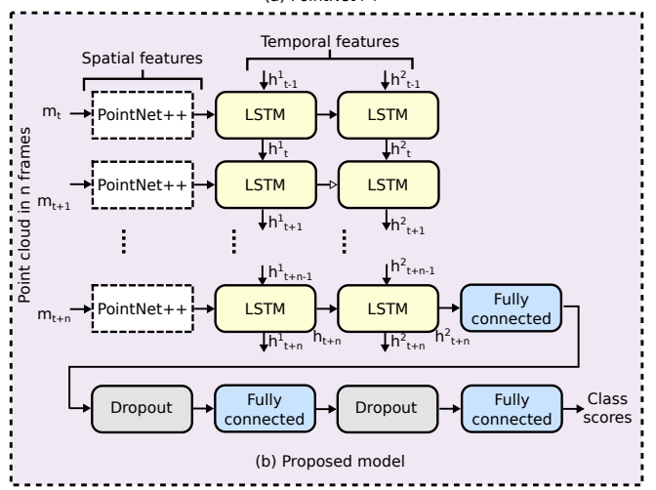
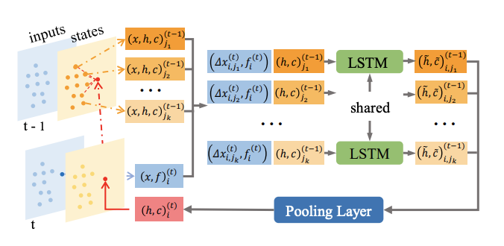
Related Work
PointLSTM, Min et al. 2020
An Efficient PointLSTM for Point Clouds Based Gesture Recognition
PointGest, Salami et al. 2020
Motion Pattern Recognition in 4D Point Clouds
Notes:
1-2 min of related work

Slide 5
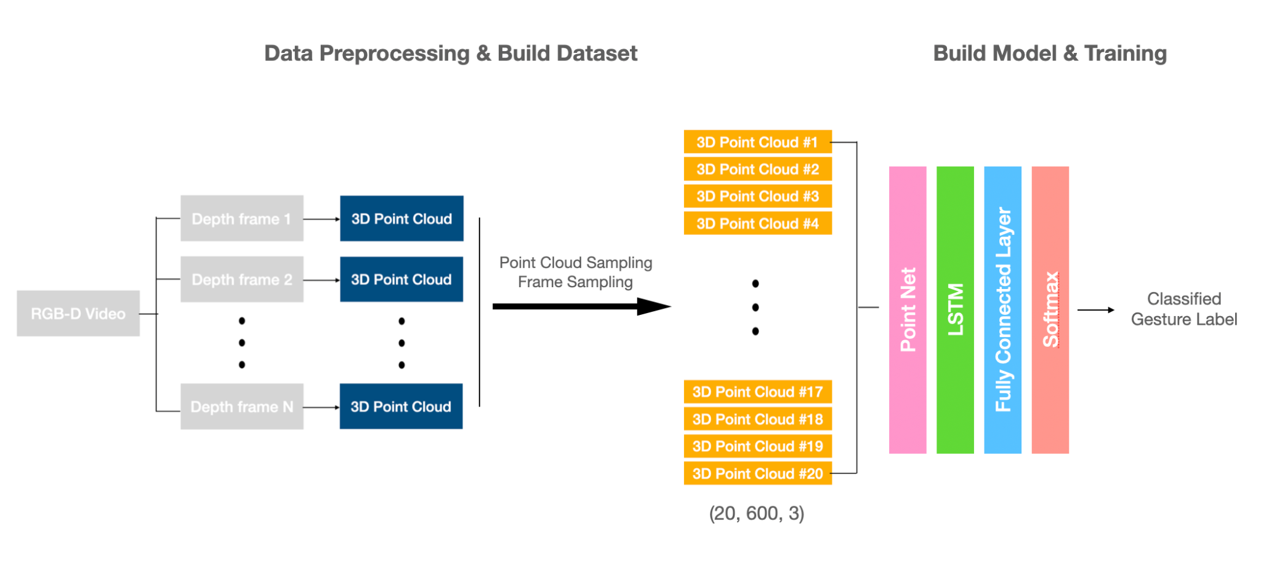
Overview of Method
Notes:
8-10 min technical details

Slide 6
DHG Dataset
A total of 2800 labeled hand gesture sequences performed by 28 participants and recorded by an Intel RealSense depth camera
Each sequence has variable lengths
Only used 1400 sequences where gestures are performed with the whole hand
14 Gestures
Grab(G), Tap(T), Expand(E), Pinch(P), Rotation Clockwise(RC), Rotation Counter-clockwise(RCC), Swipe Right(SR), Swipe Left(SL), Swipe Up(SU), Swipe Down(SD), Swipe X(SX), Swipe V(SV), Swipe +(S+), Shake(Sh)
Notes:
8-10 min technical details

Slide 7
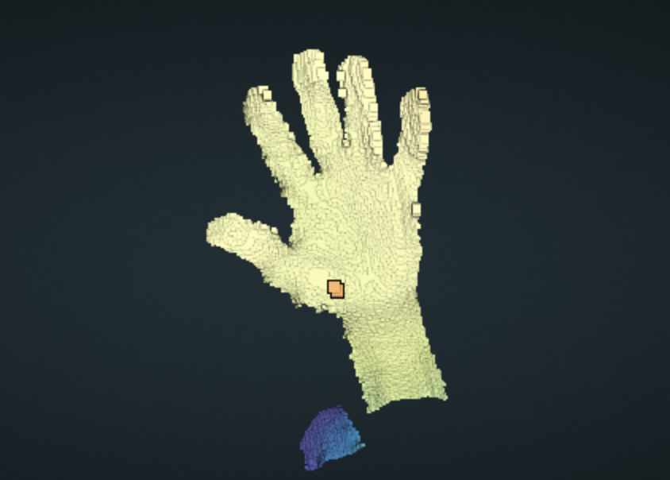
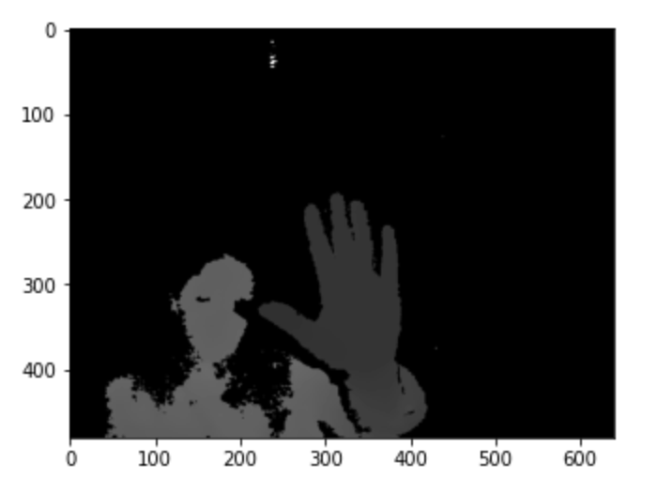
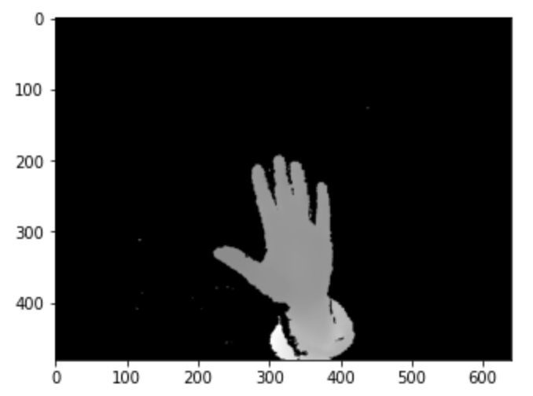
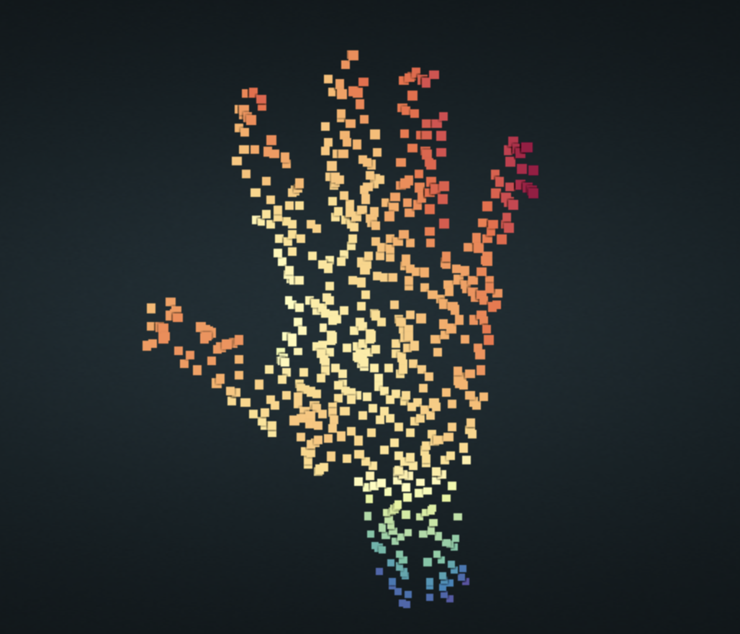
Data Preprocessing
Point Cloud
Generation
Sampling, Statistical Outlier Removal
Original Depth Frame
Hand Segmentation
600 Points
with 3D Coordinates
Notes:
8-10 min technical details

Slide 8

Data Preprocessing :: Sampling
Random Sampling
FPS Sampling

Slide 9
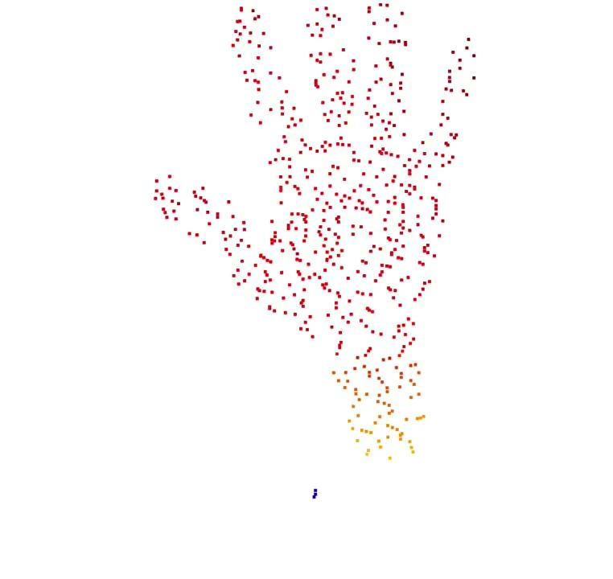
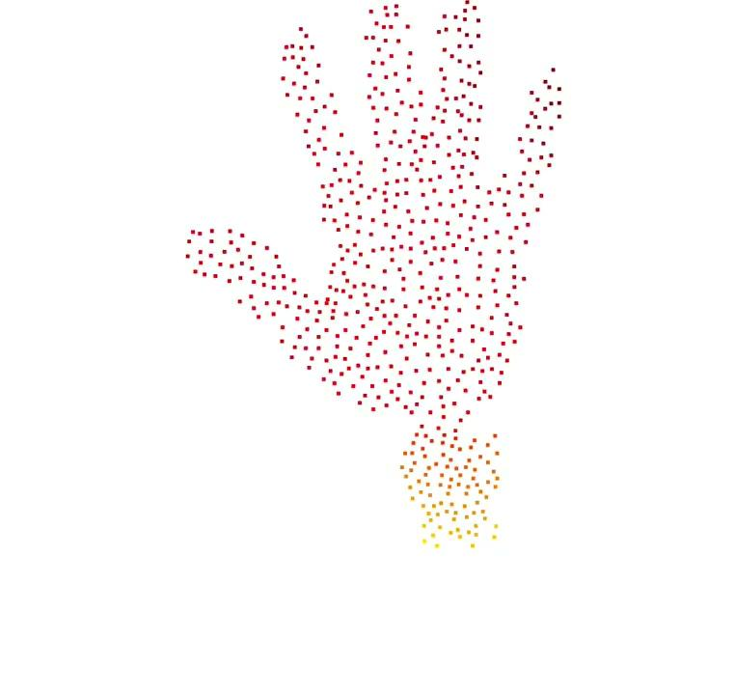
Data Preprocessing :: Sampling
Random Point Cloud Sampling + 20 Frame Sampling
FPS Sampling + 20 Frame Sampling
Notes:
grab gesture

Slide 10
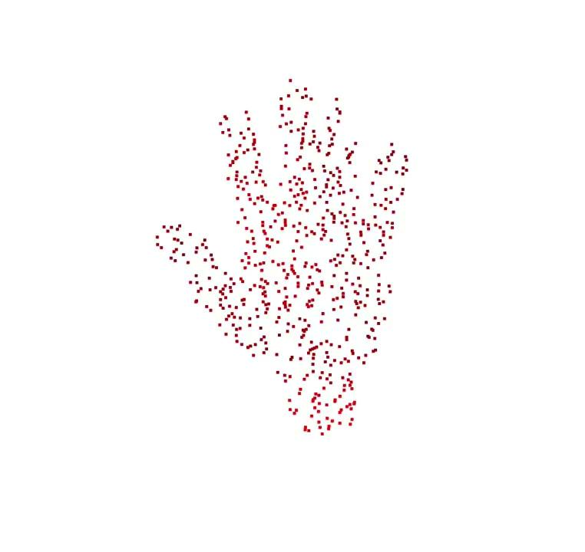
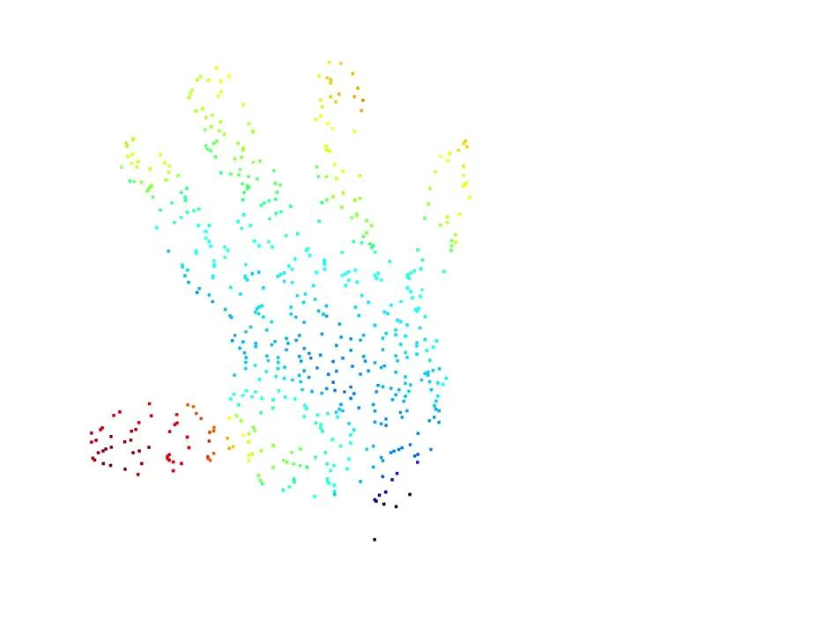
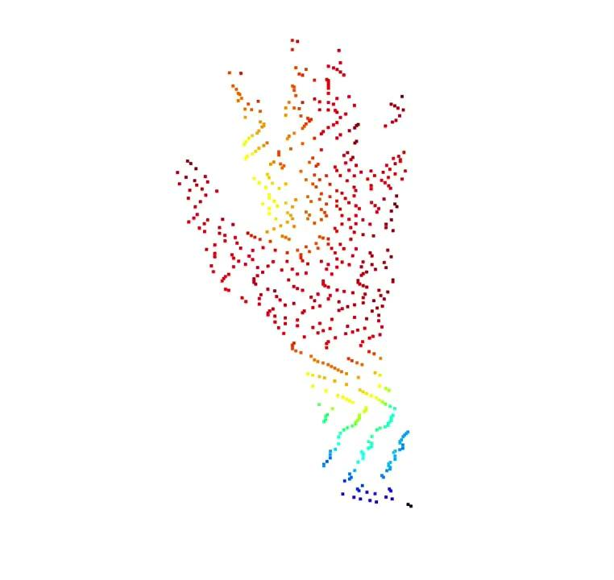
Dataset Construction Example
Expand
Rotation Clockwise
Shake
Notes:
grab gesture

Slide 11
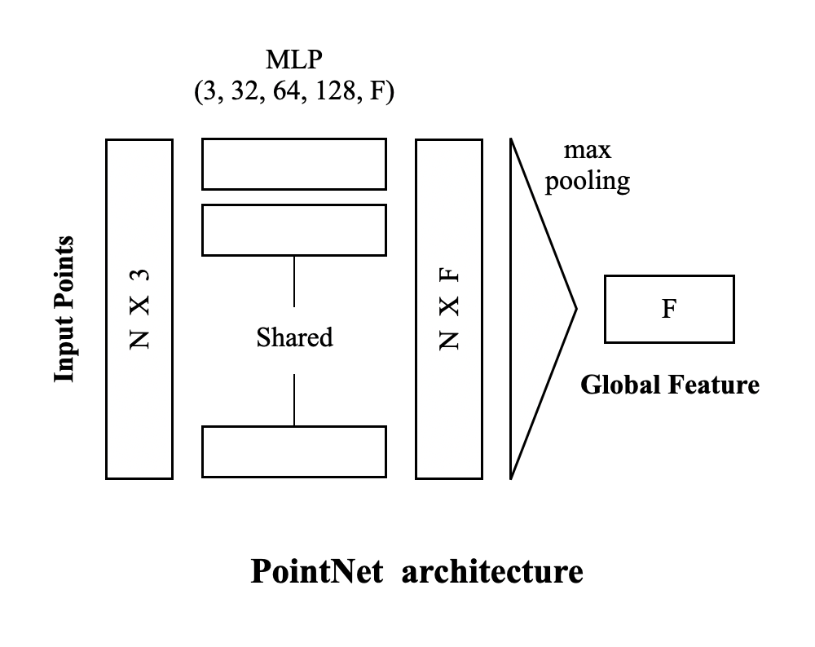
Model Architecture
Notes:
2-3 min on experiments

Slide 12
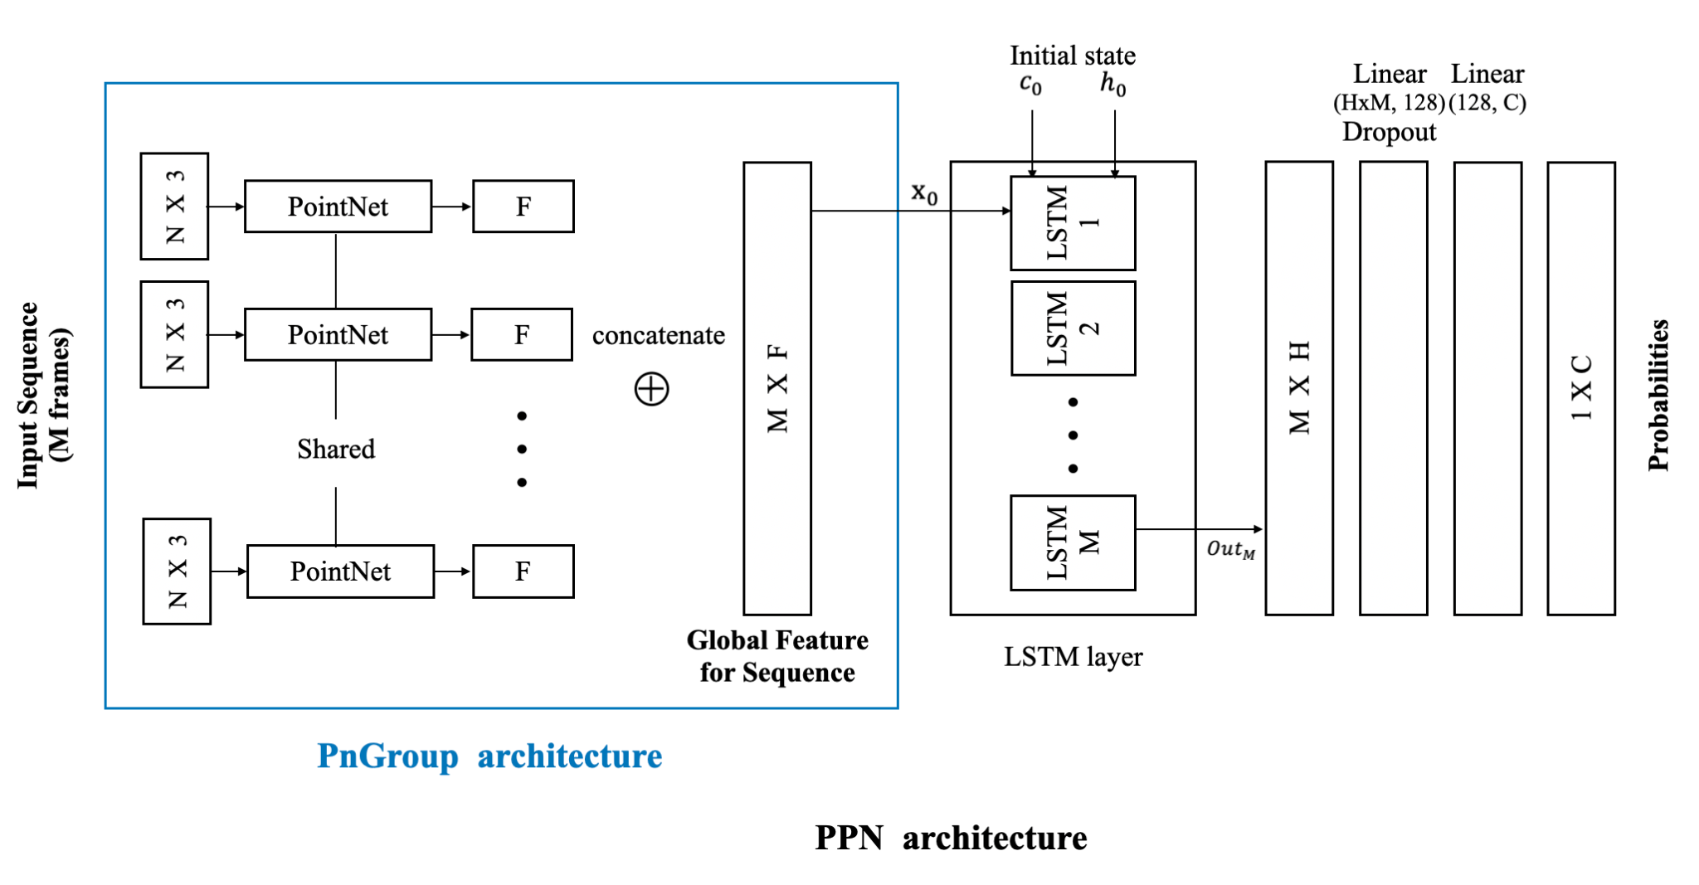
Model Architecture
Notes:
2-3 min on experiments

Slide 13
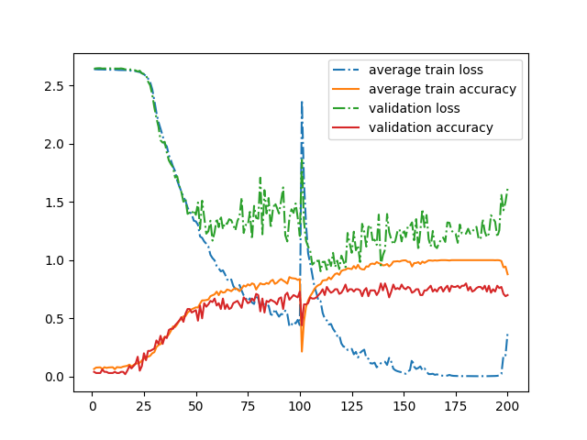
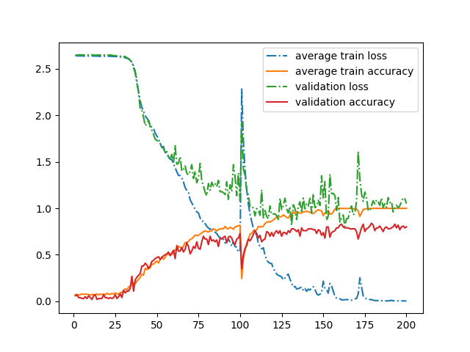
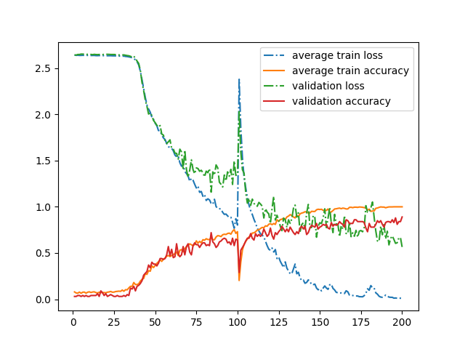
Experiment Results
wd = 1e-5
2 hidden layers
32 features
wd = 2e-4
3 hidden layers
64 features
wd = 1e-3
3 hidden layers
64 features
min val loss: 0.9065
max val accuracy: 0.83
test loss: 1.1302
test accuracy: 0.8145
min val loss: 0.5632
max val accuracy: 0.88
test loss: 0.7697
test accuracy: 0.8207
Notes:
2-3 min on experiments

Slide 14
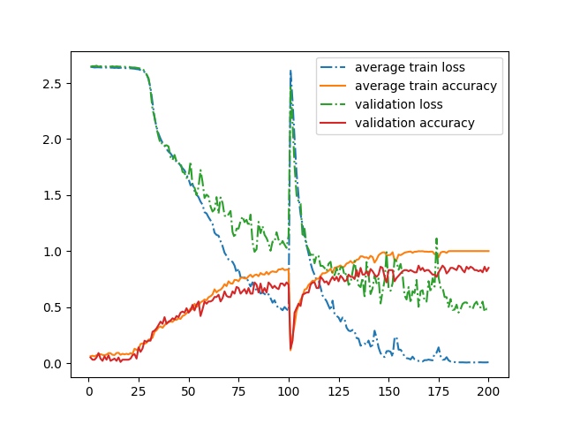
Experiment Results (continued)
wd = 1e-3
3 hidden layers
64 features
min val loss: 0.4775
max val accuracy: 0.85
test loss: 0.7329
test accuracy: 0.8428
Notes:
2-3 min on experiments

Slide 15
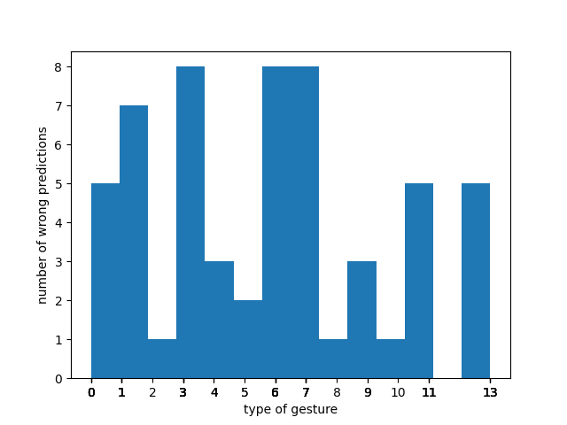
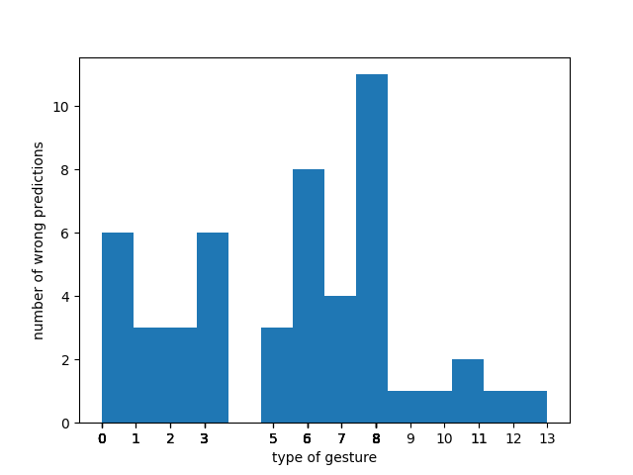
Experiment Results (continued)
Notes:
2-3 min on experiments

Slide 16
Discussion
We can improve the performance by improving the quality of dataset
hand segmentation: discretize by distance -> use other method
sampling method: random -> Farthest Point Sampling (FPS)
Tried to use FPS sampling method, but it took so long time and we were having limited computing resources.
We can improve the performance by adopting more sophisticated modules
unsupervised feature extraction approaches, e.g., autoencoder for point cloud.
Notes:
2-3 min on experiments

